Slide 1

Flight Cancellations and Delays Predictions
Group 7
Ruijing Chen\Tianyu Yao\Kangxin zheng

Slide 2

About the Project
Background: The holiday season from November to January is one of the busiest for airlines in US. Identifying flight delay and cancellation patterns can help reduce disruptions.
1
Aim of project: Predict holiday flight cancellations and estimate delays using flight data and weather conditions at origin and destination airports, identifying key factors that influence cancellations and delays.
2
Data Source: United State Department of Transportation U.S. Department of Transportation(BTS), National Oceanic and Atmospheric Administration(NOAA)
3

Slide 3
Data preprocessing
Merge data: Match hourly weather conditions to flights based on the nearest weather stations to airports (according to the latitude and longitude) and adjusted times to Central Standard Time.
Final dataset: 9 million flights for modeling, includes flight information for 383 airports（About 500,000 flights per month * 6 holiday seasons（2018-2024） * 3 months each）

Slide 4
Dataset
Flight data | Weather data
Year, Month Day of month, Day of week CRSDepTime_CST_hour CRSDepTime_CST_min Operating airline, Origin, Destination Estimated Elapsed Time Actual Elapsed Time Cancellations/Delay reasons | DryBulbtemperature （Temperature） Precipitation Visibility Present weather type Wind direction Wind speed Wind gust speed Sky Condition

Slide 5
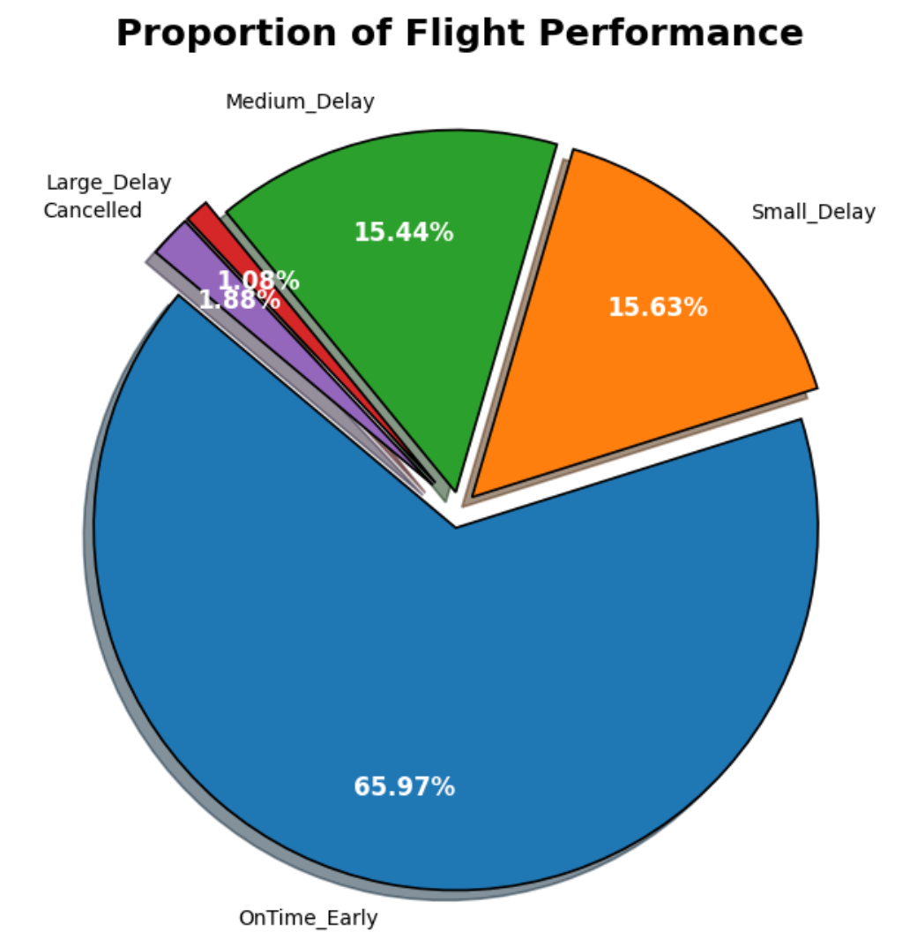
Exploratory Data Analysis
Mostly on time or early.
Very few canceled or large delay.

Slide 6
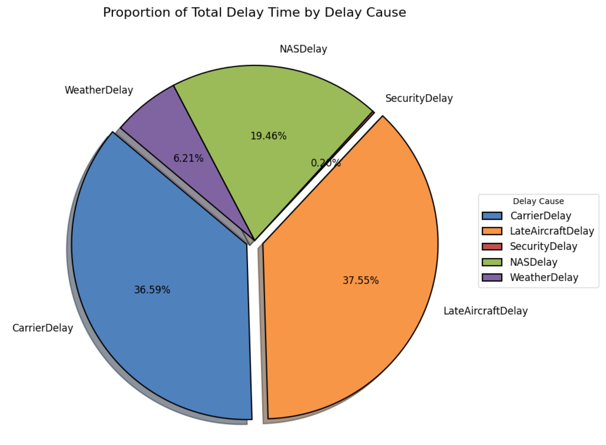
Exploratory Data Analysis
The most cause of delay:
LateAircraftDelay
CarrierDelay

Slide 7
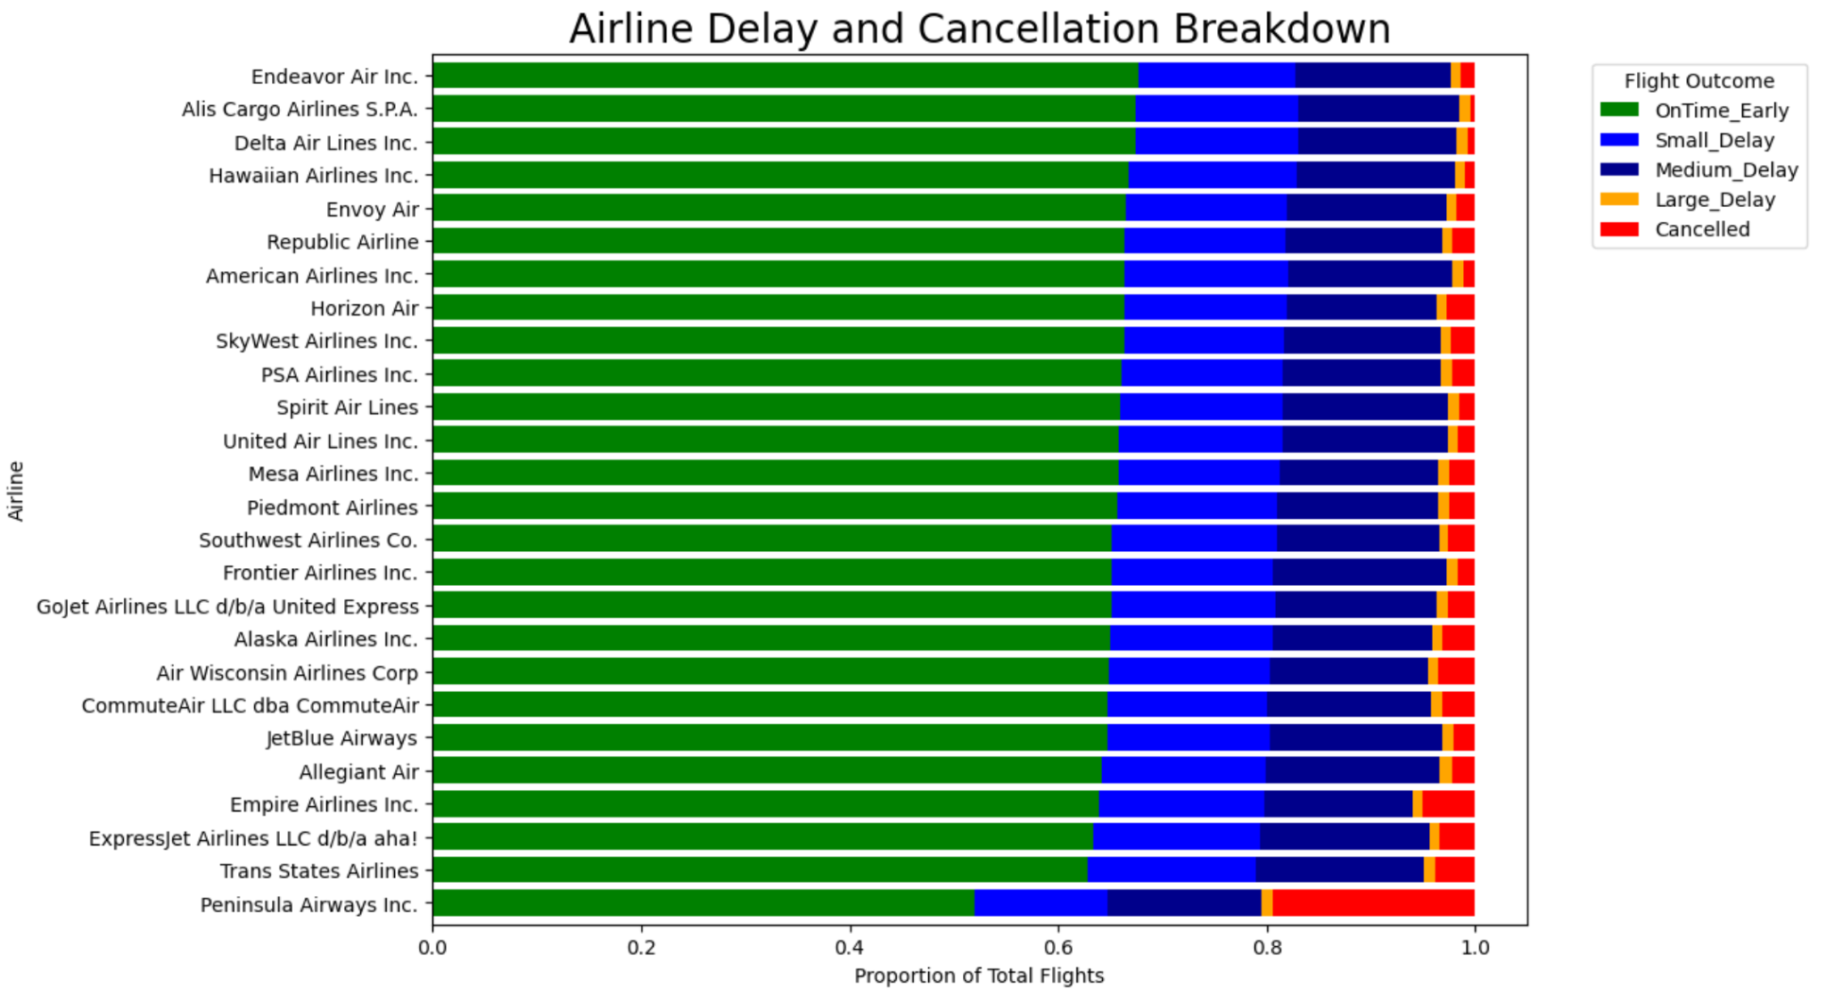
Exploratory Data Analysis
Most large delay:
Allegiant /JetBlue/Frontier
Most cancelled:
Trans States/Empire/Peninsula

Slide 8
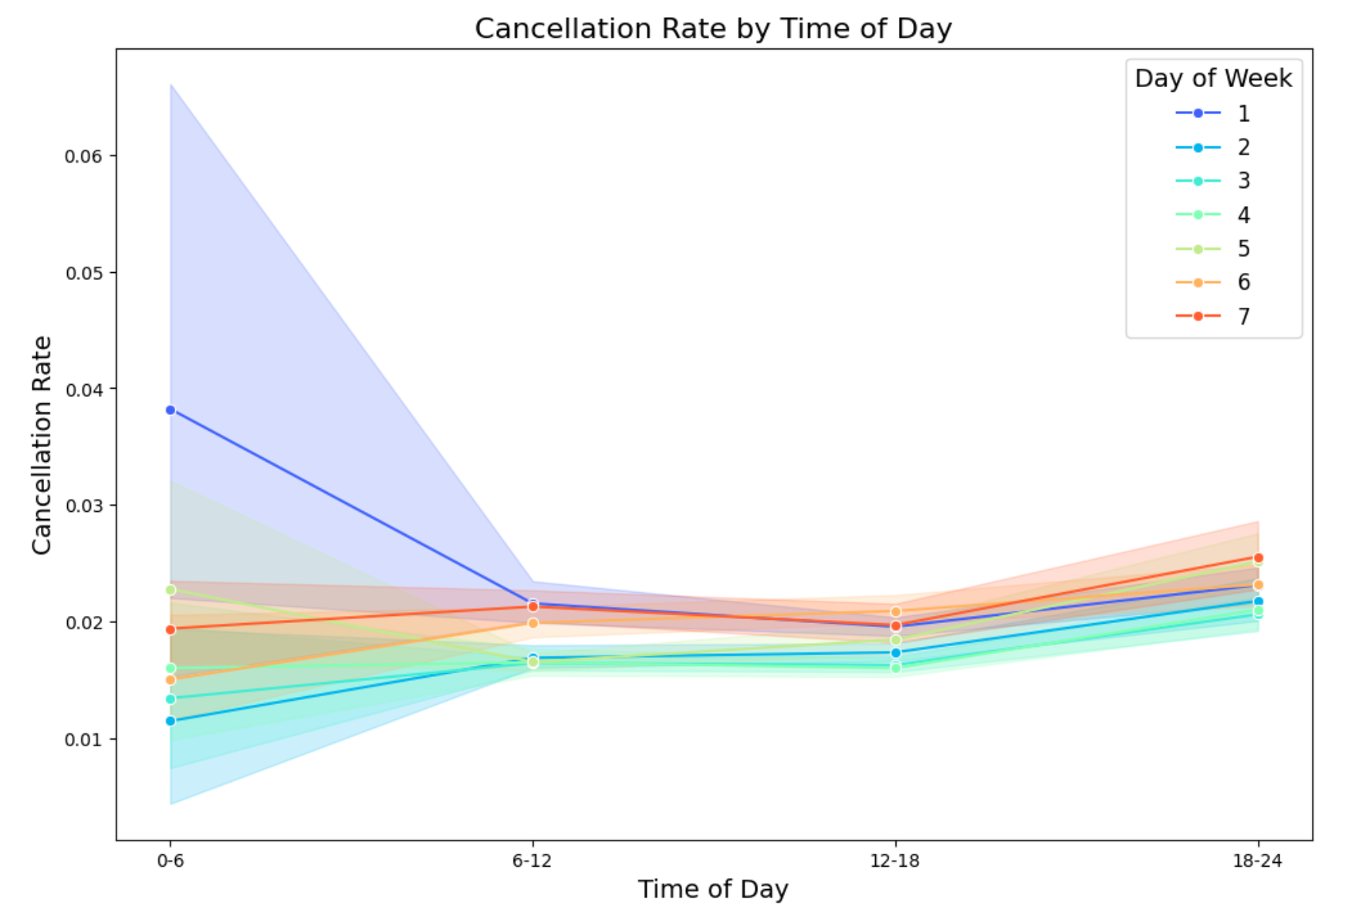
Exploratory Data Analysis
*The shaded range is for all data of that day of week, and the solid line is the mean value for that category.
Highest rate: after 18:00/during weekends
Lowest date: morning to afternoon/midweek

Slide 9
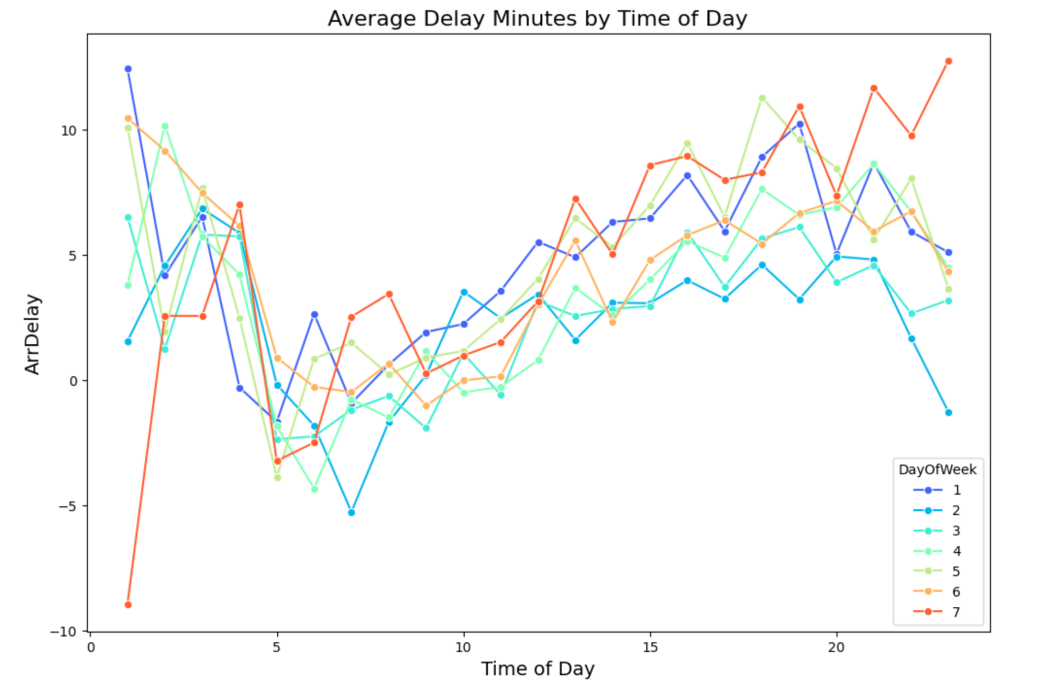
Exploratory Data Analysis
Average delay minutes increased throughout the day.
Highest: in the late evening/Sunday

Slide 10
Model Overview of Logistic Regression
The logistic regression model predicts whether a flight will be canceled based on various features.
Target Variable (y):
y = 0: Not cancelled
y = 1: Cancelled
Predictor Variables (x):
Time Features: Year, Month, Day Of Month, Day Of Week, CRSDepTime_CST, CRSElapsedTime
Flight Information: Operating_Airline, Origin, Destination (Dest)
Weather Conditions: (for both the origin and destination airports)
Altimeter Setting, Dry Bulb Temperature, Precipitation, Present Weather Type, Humidity,
Sky Conditions, Visibility, Wind Direction
Undersampling: Manually undersample the majority class (y=0, not cancelled) to balance the dataset.
After undersampling, the dataset contains:
96,460 samples of y=0 (not cancelled)
96,460 samples of y=1 (cancelled)
Notes:
Firstly, we constructed a simple logistic regression model to predict flight cancellations. In this model, the cancellation status is the dependent variable, while various features such as time, flight details, and weather conditions are used as independent variables. To address the issue of class imbalance, we performed undersampling to ensure the number of positive and negative samples is equal.

Slide 11

Feature Preprocessing
1
Categorical Features
Year and Month are treated as categorical variables to capture seasonality and yearly patterns.
2
Time Features
Hour and minute are extracted from CRSDepTime_CST to create new variables: CRSDepTime_CST_hour
and CRSDepTime_CST_min.
3
Sky Conditions
HourlySkyConditions is split into two variables: CloudHeight (numeric) and SkyCondition (categorical).
4
Wind Direction
Apply sin and cos transform to Wind Direction to capture its periodic nature.
Imputation: For missing values, impute with the values based on the same Origin, Month, and Day Of Month.
Notes:
Next, we processed the features for the subsequent steps. We treated the month and year as categorical variables since they are discrete. The hour and minute were extracted from the Certified Reservation System Departure Time (CRSDepTime), as the datetime format was not convenient for use in the model. Additionally, we split the sky conditions into numeric and categorical variables.For the wind direction, which has values ranging from 0 to 360 degrees, we applied sine and cosine transformations to convert the angular data into features, which allows us to treat 0 degrees as equivalent to 360 degrees, as the direction is cyclical.

Slide 12


Dimensionality Reduction and Feature Selection
Principal Component Analysis (PCA)
Hourly Altimeter Setting:
Humidity, Visibility, and Cloud Height:
One hot encoded for categorical variables and drop the first column
Feature Selection: Exclude sparse features
Sparse features: Variables where the proportion of non-zero values is less than 5%.
Notes:
We applied PCA to reduce dimension, starting with the altimeter settings from two airports, which showed a strong correlation. Additionally, we found that humidity, visibility, and cloud height are highly interconnected in meteorological terms. High humidity typically leads to lower cloud heights and reduced visibility, and vice versa. To capture these relationships, we applied PCA to these features as well, generating two new variables for each airport. Afterward, we performed one-hot encoding and excluded sparse features, which helped prevent the creation of singular matrices during model computation, thereby ensuring stability and improving model performance.

Slide 13

Feature Importance
( Sorted by |Odds Ratio| - 1 )
1
Very Important
2
Moderately Important
Weather type of both airports
Operating airline
Sky condition of both airports
Visibility of both airports
Year
Wind direction of both airports
Month
Precipitation of both airports
3
Less Important
4
Not Important
Origin, Destination
CRSDepTime_CST_hour, Day of week, Day of month
Altimeter setting
Dry bulb temperature of destination
CRSElapsedTime
CRSDepTime_CST_min
Dry bulb temperature of origin airports
Notes:
We assessed feature importance by calculating the absolute differences between the odds ratios and 1. The odds ratios were derived by exponentiating the model's coefficients. The results indicate that weather-related factors, including weather type, sky conditions, and visibility, are important predictors of flight cancellations, as well as the airline. On the other hand, certain date- and time-related features, such as expected flight duration and the minute of departure, have little to no significant impact on the outcome, which aligns with our intuition.

Slide 14
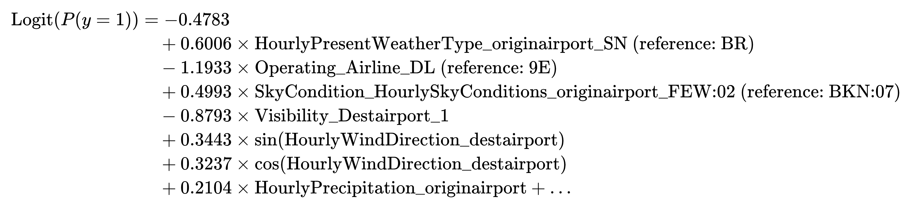

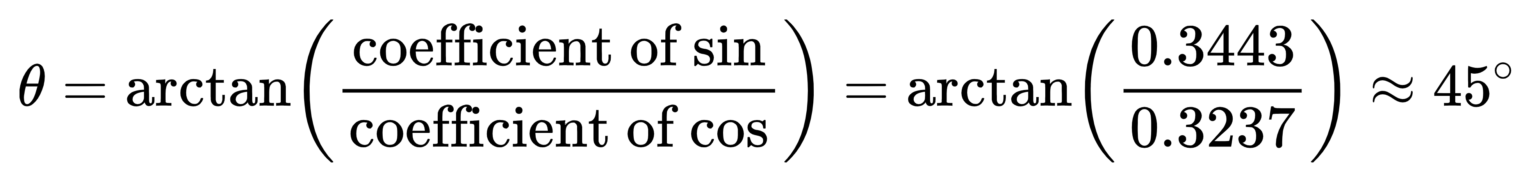
Logistic Model - Explanation
The logistic regression model for flight cancellation prediction is expressed as:
When the weather type of origin airport is “snow” (SN), the log odds of flight cancellation increase by 0.6006 compared to the baseline weather condition “fog” (BR), and the odds of flight cancellation are approximately 1.82 times higher than when the weather is fog.
The wind direction at the destination airport influences cancellations, with the most significant effect when the wind direction is approximately 45° (northeast wind).
Notes:
The equation shown expresses the log odds of a flight being canceled based on various features, such as weather conditions, airline, sky conditions, visibility, and wind direction.
For example, we can interpret the coefficient for HourlyPresentWeatherType_originairport_Snow as follows: when snow occurs at the origin airport, the log odds of a cancellation increase by 0.6 compared to when the weather is fog. This corresponds to an odds ratio of 1.82, meaning flights are about 1.82 times more likely to be canceled in snowy conditions compared to foggy ones.
Additionally, you may be curious about the what the coefficient of wind direction stands for. The combination of sin and cos coefficients allows us to calculate the primary direction of wind‘s effect, which in this case is approximately 45° representing the northeast. It means the wind direction at the destination airport has the strongest impact on cancellations when it is blowing from the northeast.

Slide 15




Take-aways for Avoiding Flight Cancellations
Weather Conditions
Wind Direction
Sky Condition and Precipitation
Operating Airline
Snowy conditions at the origin airport significantly increase the odds of cancellation.
Wind blowing from the northeast (45°) has the strongest influence on cancellations.
Some airlines may have higher cancellation rates compared to others.
These factors at both airports are significant contributors to cancellation probabilities.
Notes:
We should carefully assess weather conditions and choose the airline wisely to minimize the risk of cancellations. For instance, snowy conditions at the origin airport and winds coming from the northeast (45) have the strongest impact on cancellation rates. Flights operating under clear skies with no cloud cover are less likely to be cancelled. Additionally, flights with Endeavor Air (9E) are more likely to be cancelled compared to those with United Airlines (UA).

Slide 16
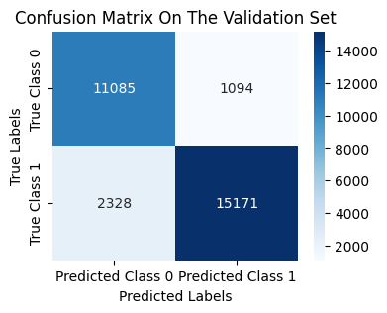

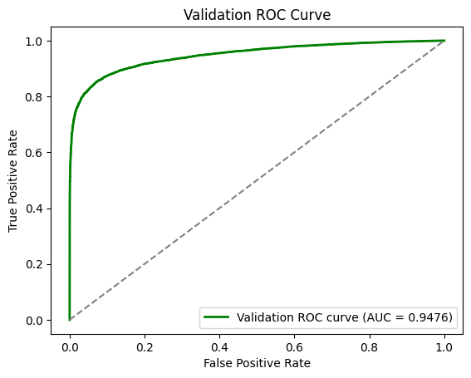
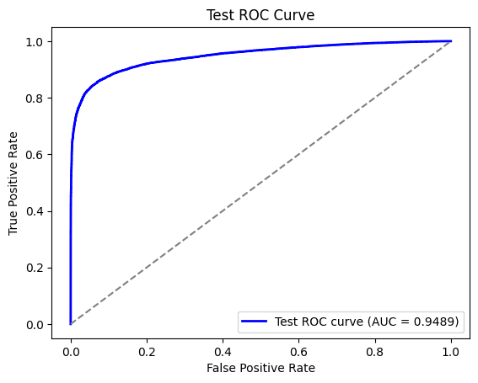
Model Fit and Performance Evaluation
Pseudo R²:
0.6007
Accuracy | 0.8847
Precision | 0.933
Recall | 0.866
F1 score | 0.898
Weighted F1 score | 0.889
Accuracy | 0.8860
Precision | 0.933
Recall | 0.872
F1 score | 0.902
Weighted F1 score | 0.896
Notes:
The model explains 60% of the variation in flight cancellations, as indicated by a pseudo R² value of 0.6. It also demonstrates high accuracy and performs well across other evaluation criteria. Furthermore, the ROC curve is close to the top-left corner, indicating the model's strong predictive ability.Its performance is stable across validation and test sets, with high accuracy and AUC scores indicating strong predictive power.

Slide 17




Model Diagnostics and Significance Testing
Feature Significance
All features included in the model have p-values < 0.005, indicating they are statistically significant predictors.
Likelihood Ratio Test
LLR p-value of 0.000 indicates that the model is statistically significant in predicting flight cancellations.
Multicollinearity Check
Variance Inflation Factor (VIF) < 10 for all features, confirming that multicollinearity is not an issue in the model.
Notes:
In this page, we show the key diagnostic results of the model. The p-values ​​of all features and the likelihood ratio test are less than 0.005, proving that each variable and the model has a good predictive effect.Finally, by checking the VIF, we confirmed that there were no multicollinearity issues.

Slide 18



Strengths and Weaknesses
Strengths
High Interpretability
Good Fit and high accuracy
Simplicity and Fast Processing Speed
Weaknesses
Exclusion of Sparse Features
Residual Independence Assumption not fully satisfied
with Durbin-Watson Statistic: 0.93
Notes:
The model has high interpretability,accuracy and fast processing speed.
While the removal of sparse variables leads to reduced predictive power for certain types of airports or weather conditions that do not belong to any common categories.
The model does not fully satisfy the assumption of residual independence, which could lead to potential model bias.

Slide 19

Model-LightGBM（gradient boosting model）
WHY LightGBM:
faster processing with large datasets
outperforms other models in recent studies(Kiliç, Kerim, and Jose,2023; Stefanovič,et al.,2020)
HOW LightGBM Works:
uses an ensemble of decision tree to prevent overfitting.
leaf-wise tree growth makes it faster and more efficient, especially with big datasets.
Notes:
starts with a single, simple decision tree
After the first tree makes its guesses, LightGBM sees where the tree made mistakes. It then creates another tree specifically designed to fix those mistakes. This process of learning from previous errors continues, with each new tree improving upon the last.
Combining Decisions: Once enough trees have been built, LightGBM combines them. Each tree contributes to the final prediction, making the overall result more accurate. Essentially, LightGBM is like having a group of “experts,” each adding a piece to the puzzle to make the best possible prediction.
Efficient Learning: LightGBM is specifically designed to be fast. It doesn’t look at every piece of data every time it learns, which would be slow. Instead, it picks only the most important parts of the data, which allows it to learn quickly while maintaining accuracy.
ne thing that makes LightGBM different from other decision tree models is that it grows its trees in a "leaf-wise" way. It focuses on growing the parts of the tree where the model can improve the most, rather than just splitting everything evenly. This makes it faster and more efficient, especially with big datasets.
Gradient represents the slope of the tangent of the loss function, so logically if the gradient of data points are large in some sense, these points are important for finding the optimal split point as they have a higher error.

Slide 20
Model training
Target Variable (y): Arrival Delay Minutes
Predictors: flight data(airports,airline,flight date…)
weather data (Precipitation,Temperature…)
70% -- Training dataset /15% for Validation dataset/15% for Testing dataset
Target encoding for categorical variables
--replacing each category with a numerical value based on the target variable(delay minutes)
--smoothing to handle rare categories more effectively
Performance: RMSE=30.18 MAE=14.95
Notes:
: Used to fit the model and learn the patterns: Used for hyperparameter tuning and selecting the best mod
validation set for hypertuning also references
el configuration. : Held out to evaluate final model performance and avoid overfitting.

Slide 21
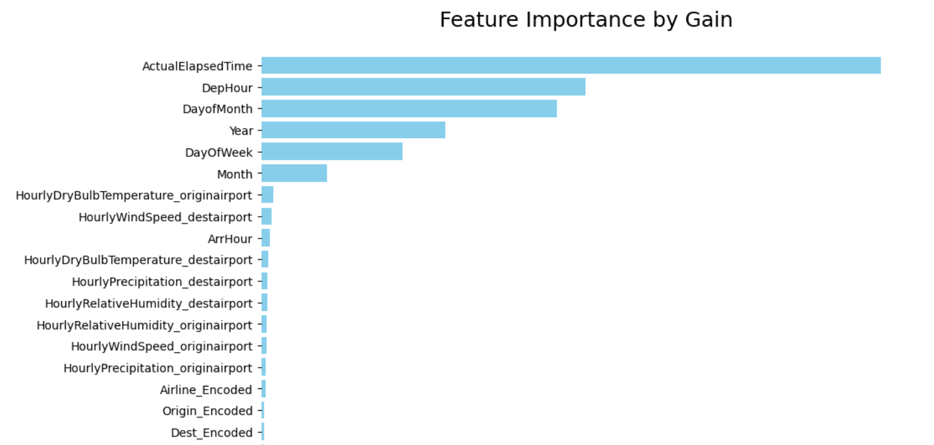
Feature Importance
Flight duration
Flight date:
Departure hour
Day of Week
…
Weather:
Temperature
Precipitation
Windspeed
Humidity
Airline
Airports

Slide 22
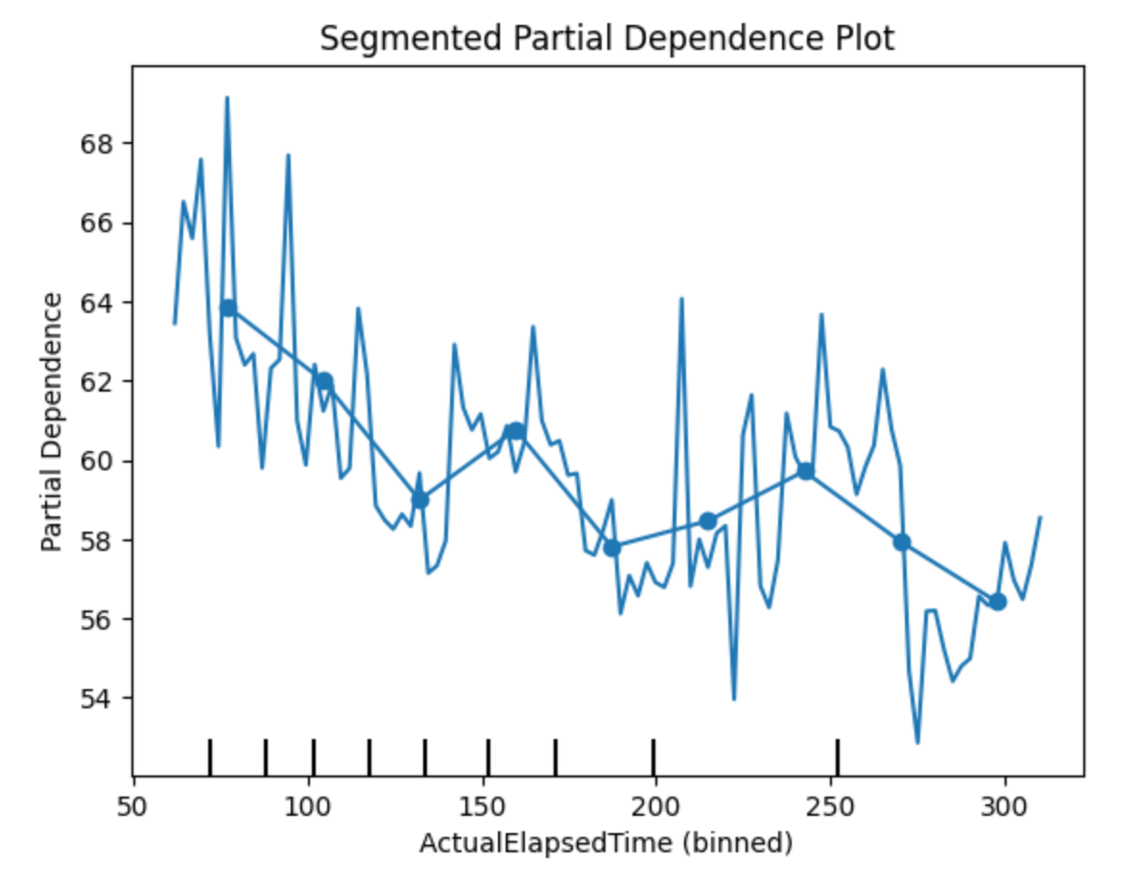
Impact of flight duration
A partial dependence plot shows the marginal effect of a feature on the model’s predictions.
A negative slope indicates a negative relationship between feature and predicted outcome.
Shorter flights have longer delay minutes.
Notes:
, the PDP curve represents the average predicted outcome as the feature value changes, holding other features constant
A negative slope means that as the feature value increases, the predicted outcome decreases, indicating a negative relationship.
The y-axis in this plot, labeled as "Partial Dependence," represents the effect of the "Day of Week" variable on the predicted delay minutes in the context of your model. Specifically, it shows how the expected delay changes when each day of the week varies, while keeping other features constant.
In partial dependence plots, higher values on the y-axis indicate a larger positive contribution to delay minutes for that specific day, while lower values suggest a smaller or even negative contribution. Here, the y-axis values reflect the model's predicted influence of each day of the week on delay time, helping you understand how delays are expected to fluctuate based on the day alone.

Slide 23
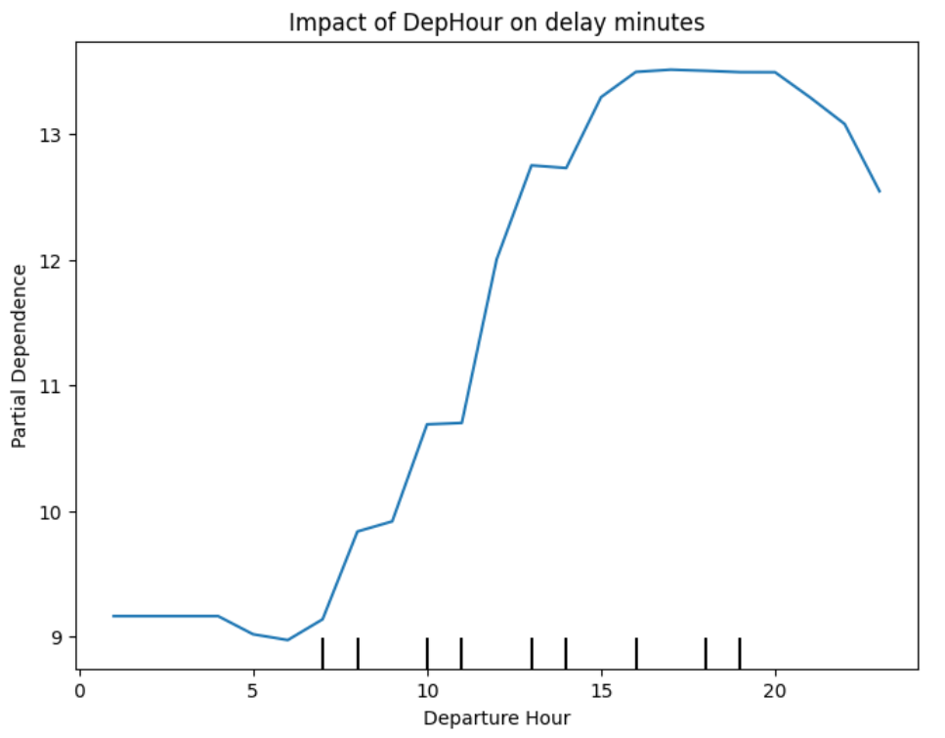
Impact of departure time
Relatively low and stable in the early morning hours
Noticeable increase in delay minutes as the departure hour moves from early morning toward afternoon,
Peak around midday to evening(around 20:00).
Notes:
indicating that flights departing in this time window experience fewer delays on average.
suggesting that flights departing during this period may be more susceptible to delays. This could be due to increased air traffic or operational constraints as more flights start to depart.
flights departing during these hours are more likely to encounter delays, possibly due to peak traffic periods, congestion, or weather factors that are more prevalent in the middle of the day.

Slide 24
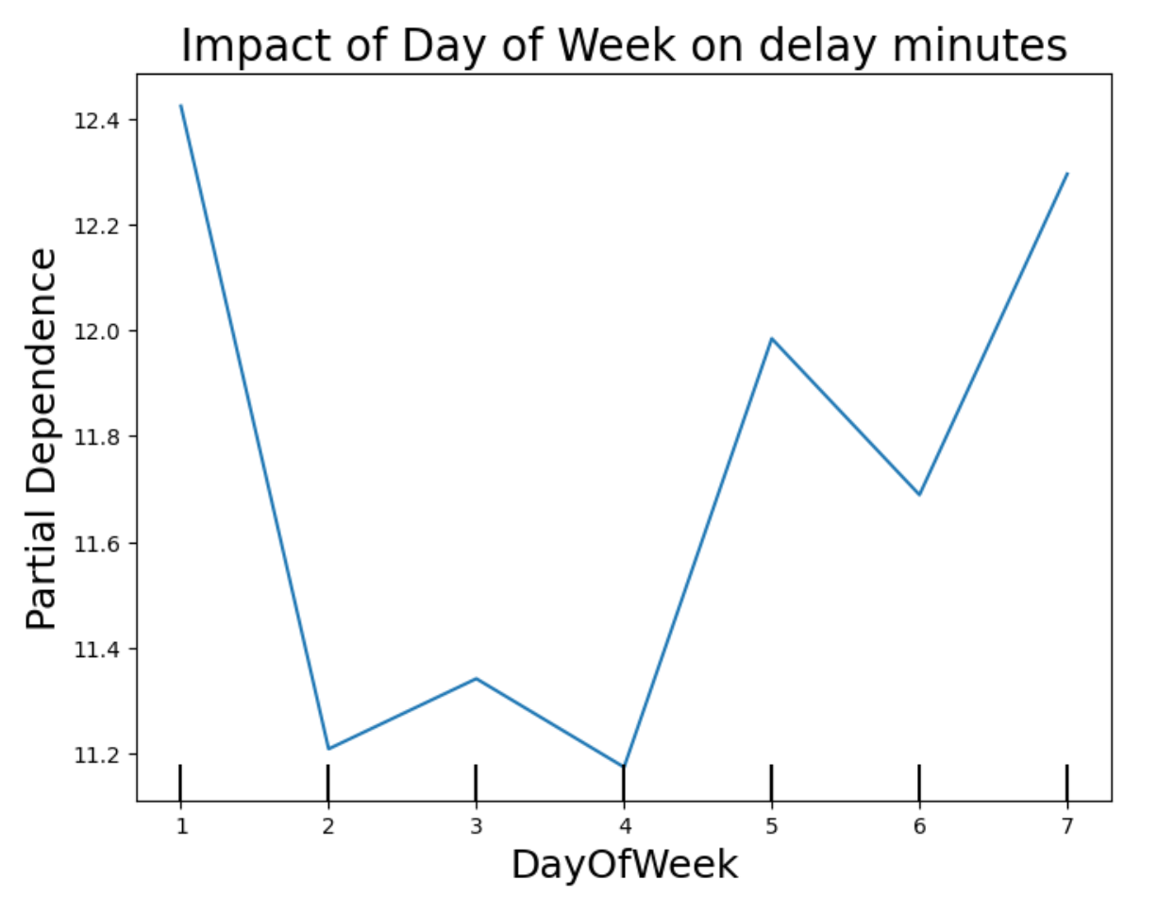
Impact of day of week
Shorter delay minutes during the midweek, possibly due to lower flight traffic.
Notes:
Monday (1): Delay time is relatively high, which may indicate that the start of the workweek has more flight delays.Tuesday to Thursday (2 to 4): Delay time decreases, suggesting fewer delays during the midweek, possibly due to lower flight traffic or more efficient operations.Friday to Sunday (5 to 7): Delay time starts to increase, especially on Sunday (7), where delays reach close to the highest level shown on the plot. This could reflect increased weekend flight traffic leading to more delays.

Slide 25
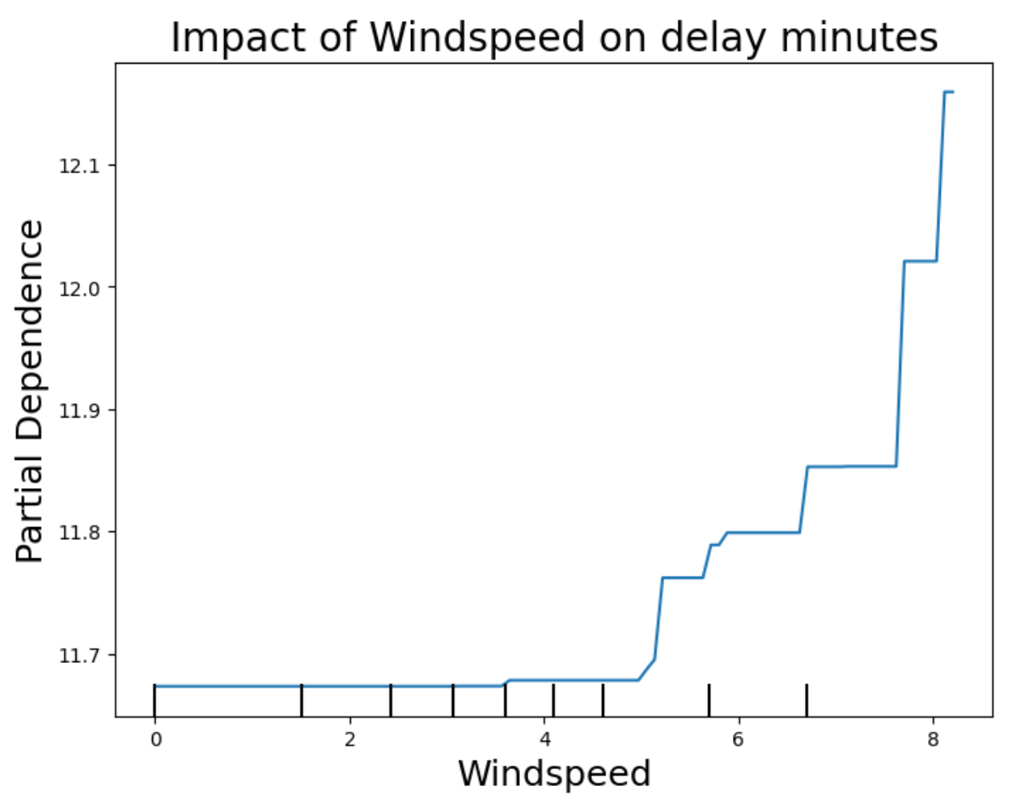
Impact of wind speed
Increase in delay minutes as wind speed rises
Notes:
The plot suggests a general increase in delay minutes as wind speed rises. For wind speeds up to around 4 units, the delay impact remains fairly constant. After 4 units, we see a sharp increase, especially past 6 units, where the delay impact rises significantly.
Insights
Threshold Effect: Wind speed below 4 units appears to have a minimal effect on delay times, suggesting that light winds do not significantly disrupt flights.
Increasing Delays at Higher Winds: As wind speed crosses around 6 units, there is a noticeable rise in predicted delay minutes. This pattern may indicate that moderate to high wind speeds contribute substantially to flight delays, possibly due to safety protocols or operational adjustments required in windy conditions.
Operational Impact: Airlines and airports might need to prepare for higher delays when wind speeds exceed 6 units, as this level of wind could affect takeoffs, landings, or ground operations.

Slide 26

TAKEAWAY TO AVOID DELAY
Choose flights that (are):
Longer than
2 hours
Depart in
early morning
Depart in midweek
Avoid windy days/cold places
Shorter flights tend to have higher delay minutes.
Delay minutes are relatively low in the early morning.
Delay minutes are relatively low in the midweek.
High windspeed(>4 mps) will lead to higher delay minutes.
Airports with lower temperature(<5⁰C）have longer delay.
Notes:
The plot suggests a general increase in delay minutes as wind speed rises. For wind speeds up to around 4 units, the delay impact remains fairly constant. After 4 units, we see a sharp increase, especially past 6 units, where the delay impact rises significantly.
Insights
Threshold Effect: Wind speed below 4 units appears to have a minimal effect on delay times, suggesting that light winds do not significantly disrupt flights.
Increasing Delays at Higher Winds: As wind speed crosses around 6 units, there is a noticeable rise in predicted delay minutes. This pattern may indicate that moderate to high wind speeds contribute substantially to flight delays, possibly due to safety protocols or operational adjustments required in windy conditions.
Operational Impact: Airlines and airports might need to prepare for higher delays when wind speeds exceed 6 units, as this level of wind could affect takeoffs, landings, or ground operations.

Slide 27
Strengths and Weaknesses
Strengths
LightGBM has proved better performance than other models on predicting flight delay
Apply target encoding captures the direct relationship between each category and the target variable.
provide a smoothed estimate based on a combination of the category mean and the global mean, allowing the model to handle rare categories more effectively
.
Weaknesses
Space for RMSE improvement
Adding feature describing propagation
LightGBM is highly dependent on tuning hyperparameters, which needs more effort

Slide 28
Visualization for
flight arrival time prediction
https://crj2002.shinyapps.io/shiny/

